Slide 2
Events of Swarming
Rapid growth in amount of worker brood
Crowding of the colony
Queen cup construction
Queen cell construction (10-15 days prior)
Good weather
Engorgement of Honey
Exodus

Slide 3
Causes of Swarming
Dilution of queen pheromone
Lack of space for queen to lay eggs
Abundance of resources
Genetic strain of bees
Age of queen
Environmental conditions

Slide 4
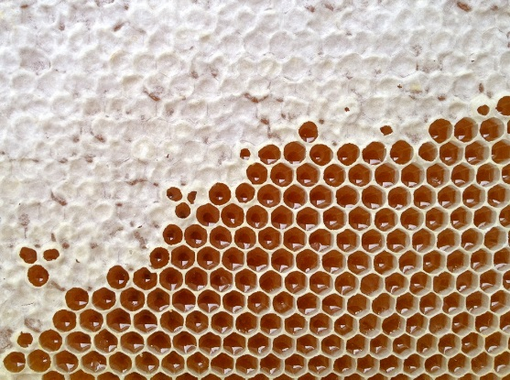
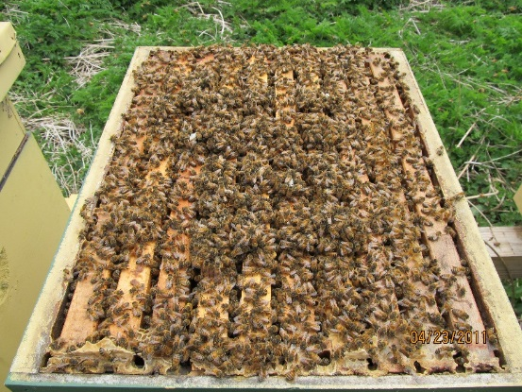
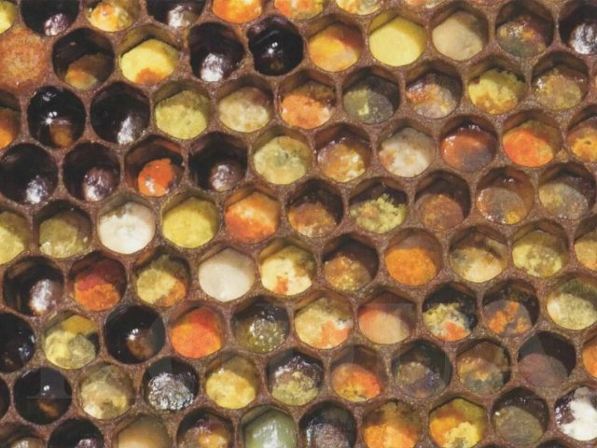
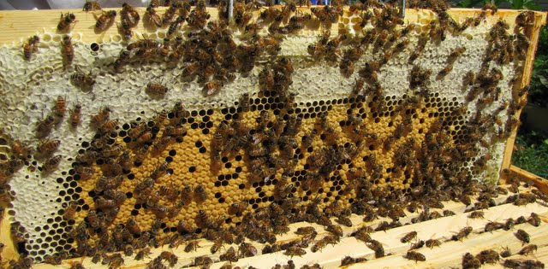
Pre-Swarm Conditions

Slide 5
Colony Growth

Slide 6
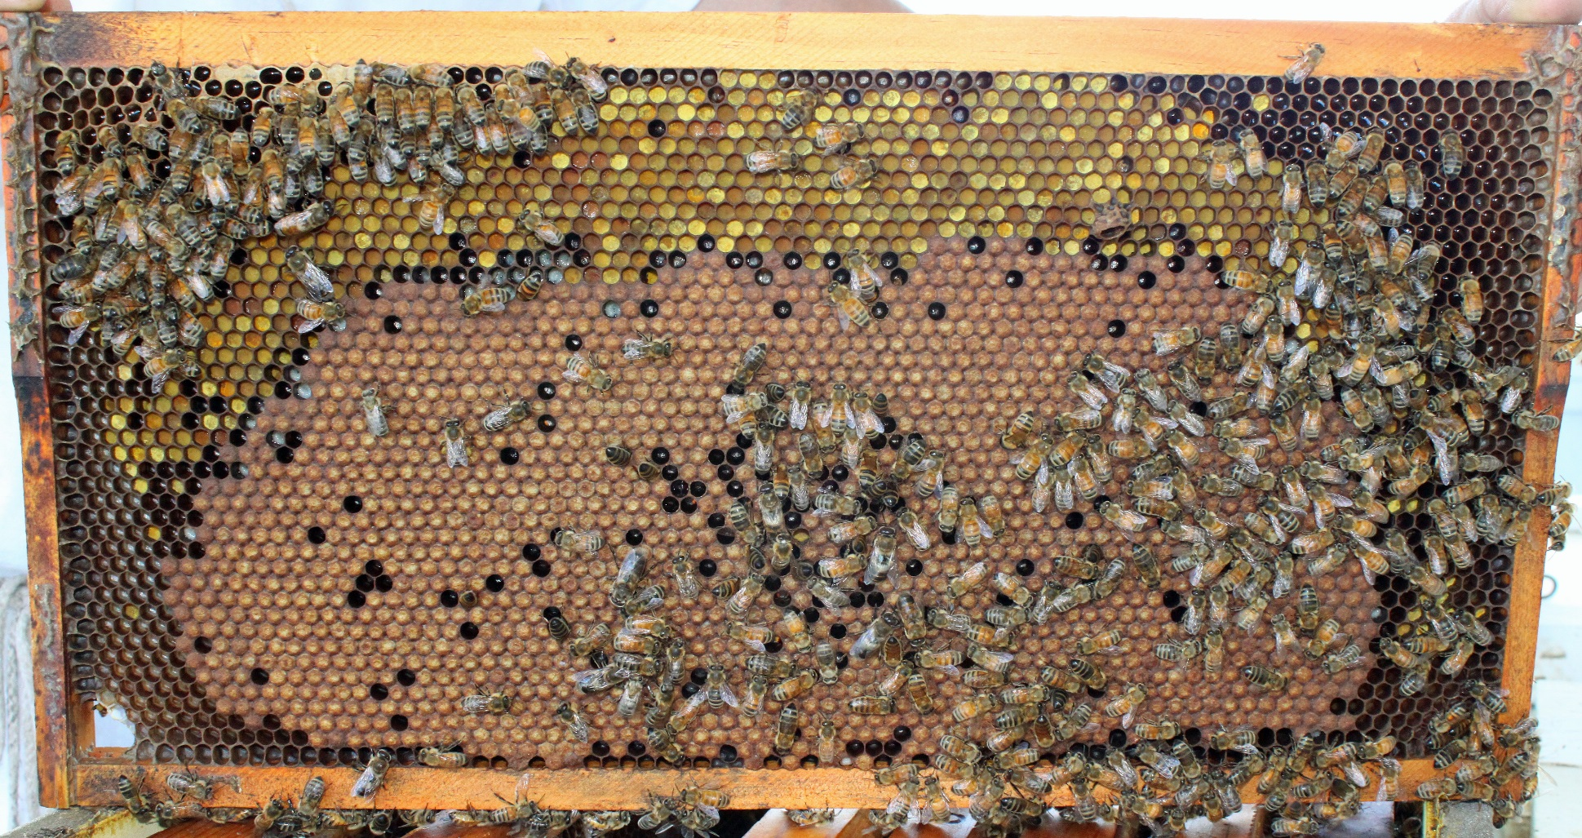
Crowded with Good Nutrition

Slide 7
Timing of Swarming
New York: May-June, peaks in June
Pennsylvania: May-June, peaks in late May
Arkansas: April-May, peaks in early May
Louisiana: March-May, peaks in April

Slide 8
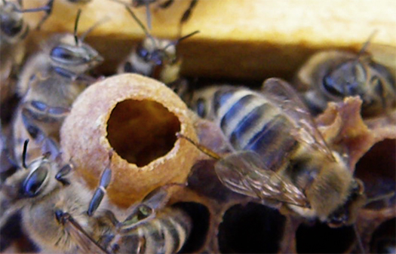
Many Queen Cups → weeks from swarming

Slide 9
Getting Ready to Swarm
Broodnest
Time until Swarming
Many queen cups go time, swarming in weeks
Eggs in cups will swarm in 8-10 days
Capped cells any moment

Slide 10
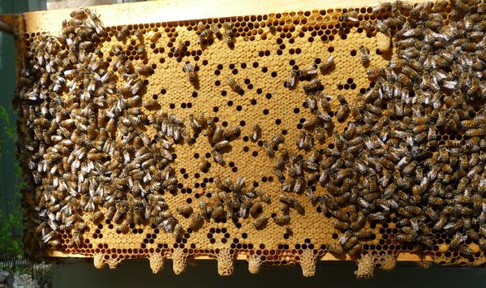
Swarm Cells located on bottom of combs
(easily seen by tilting back brood boxes)

Slide 11
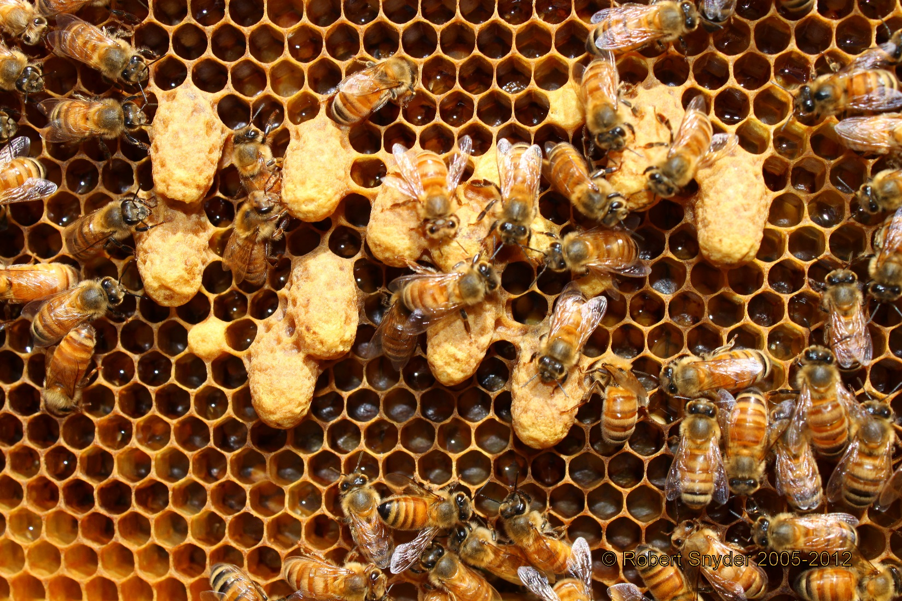
Emergency Queen Cells located anywhere, and they are usually shorter than swarm cells

Slide 12
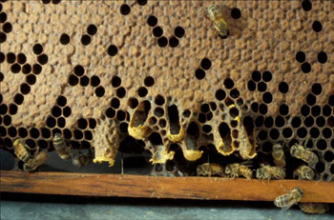
Queen cells being chewed down after a virgin queen has emerged

Slide 13
It Already Swarmed!
Broodnest
Likely time of Swarm
Open brood is present recent, 0-4 days
Sealed but no open brood more than 4-5 days
No brood but there swarmed > 3 weeks,
are remains of queen cells new queen not laying yet
Multiple eggs in cells > 28 days ago, new queen
failed, laying workers

Slide 14
Timing of Splits or Nucs
Wrong time – waste of time, bees and money
Best time – mid-spring but before major honey flow
Good sign – 1st drone flights and swarm season beginning
MUST have adequate food in all units that are budded or split from a hive
General Rule: Earlier and Stronger Spilts Ensure Greater Success or Survival of Splits or Nucs

Slide 15
Timing of Splits or Nucs
Earliest good pollen → maples in Jan.
Begin feeding 50:50 syrup in Feb. – March
Add protein supplement if pollen becomes intermittent (start end of Jan. – March)
Must be prepared to split in March – April to avoid swarming

Slide 16
Feeding Sucrose
33% Syrup: trickle; stimulates brood rearing
4.2 lbs. sucrose + 1 gallon water (makes 1.2 gallons syrup)
50% Syrup: spring feeding
8.3 lbs. sucrose + 1 gallon water (makes 1.6 gallons syrup)
Thick Syrup (67%): autumn feeding
16.6 lbs. sucrose + 1 gallon water (makes 2.3 gallons syrup)

Slide 17
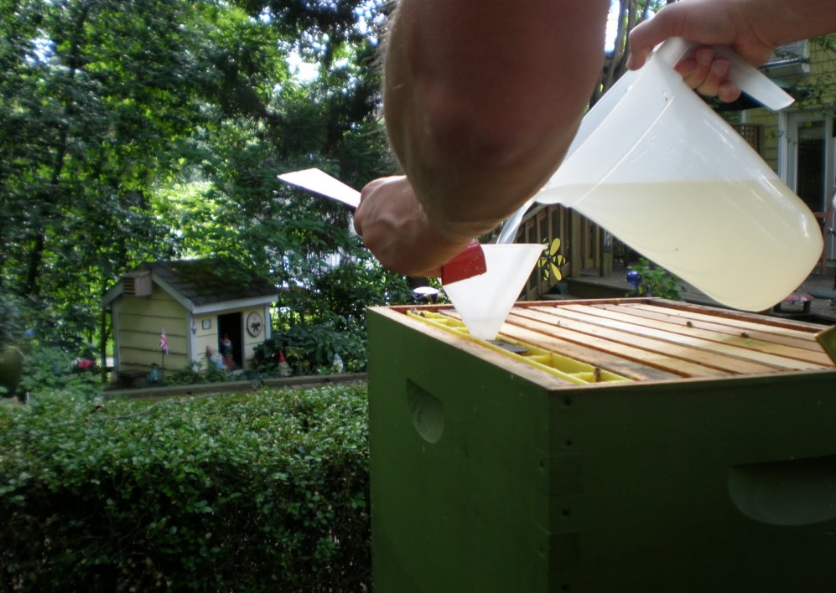
Feeding Colonies (division board)

Slide 18
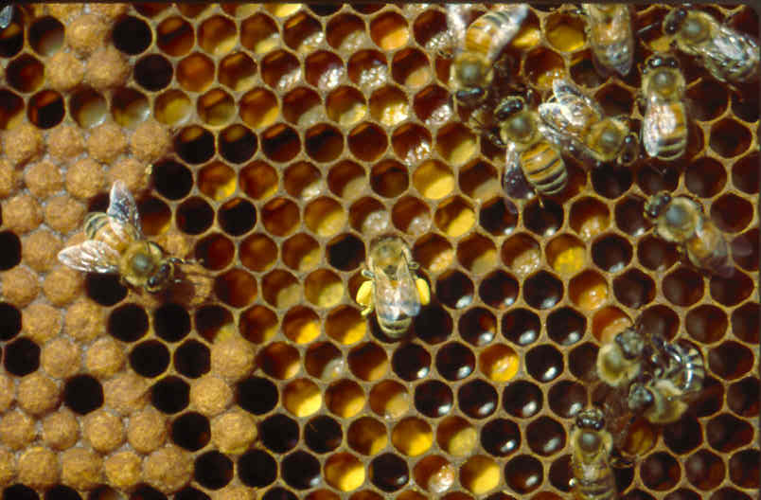
Bee Bread
Pollen + Microflora

Slide 19
Commercial Protein Supplements
Global Patties
MegaBee
BeePro
Bee-Pol
Feed-Bee

Slide 20
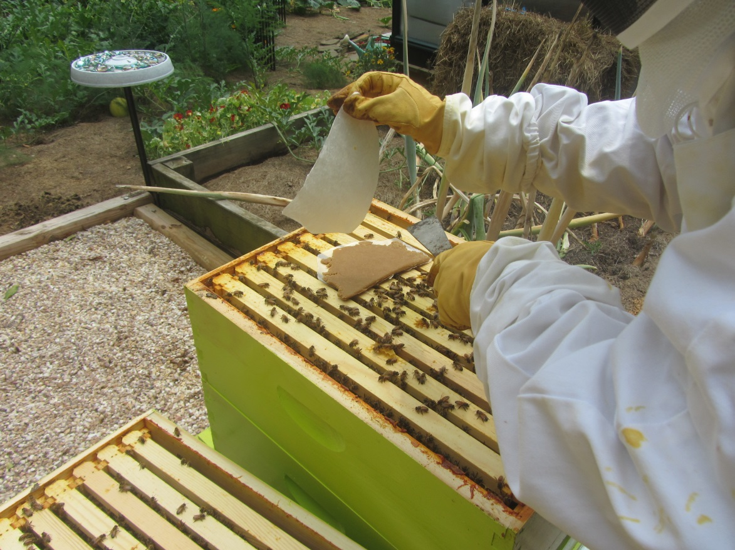
Protein Supplements
Place patties close to broodnest
Feed a light syrup at the same time; helps stimulate brood rearing
Be careful in cooler periods!

Slide 21
Measures of Quality
Increased brood production; colony growth
Increased worker longevity
Increased blood vitellogenin
Boost in immune functions (e.g. pro-phenol oxidase)

Slide 22
Timing of Splits or Nucs
The best colony size for splits is 2-3 deeps full of bees and brood
Splitting can be governed by availability of QUEENS
Bees will respond best to feeding during the natural period of spring build-up

Slide 23
How much to Feed
1-2 gallons of sugar syrup during 3-4 weeks prior to splitting
One third pollen patty every 2-4 days for the same period of time
Add empty combs to avoid becoming honey bound – delicate balance between growing and crowding!

